Slide 1

Project Title - Seasonal Agriculture Performance Data Analytics
Student Name – TILAK RAM
College Name - GURU RAM DAS INSTITUTE OF MANAGEMENT & TECHNOLOGY
AICTE STU ID : STU67285ac0342081730697920

Slide 2

PROBLEM STATEMENT
Agricultural activities are influenced by seasonal variations in environmental conditions, farming practices, resource availability and market conditions. As a result, agricultural performance may differ from one season to another. However, raw agricultural data does not clearly explain how agricultural performance changes across seasons or what patterns can be observed in different seasonal conditions.
The problem is to analyze the given agricultural dataset and investigate seasonal differences in agricultural performance by identifying meaningful patterns, trends, relationships and variations within the available data.

Slide 3
Project Description Seasonal Agriculture Performance Analytics: Analyzed agricultural data across seasons to reveal profound variations in profitability & yield. Identified Kharif as most profitable (favorable conditions) & Zaid as least (harsh conditions), even for staple crops. Recommended optimizing profitable seasons & strategic re-evaluation for Zaid farming.

Slide 4

WHO ARE THE END USERS?
Business Executives & Decision Makers
Data Analysts & Researchers
Departmental Managers

Slide 5

Technology Used
Programming Language: Python 3.x
Data Processing: Pandas, NumPy
Visualization Libraries: Matplotlib, Seaborn, Plotly / Power BI / Tableau
Environment / IDE: Jupyter Notebook / Google Colab / VS Code
Version Control: Git & GitHub

Slide 6
RESULTS
Data Preprocessing & Exploratory Analysis
Focus: Data Cleaning, Summary Statistics, and Distribution Analysis.
Key Insights: Handled missing values, removed outliers, and validated data types to ensure high analytical accuracy.

Slide 7
RESULTS
Trend Analysis & KPI Dashboard
Focus: Visual Insights & Correlation Analysis.
Key Insights: Evaluated historical trends across key parameters and identified strong correlations between primary feature variables using heatmaps.

Slide 8
RESULTS
Comparative & Interactive Visualizations
Focus: Segment Comparison & Final Output.
Key Insights: Highlighted top-performing categories and anomalous variations, providing clear visual metrics for business decision-making.

Slide 9
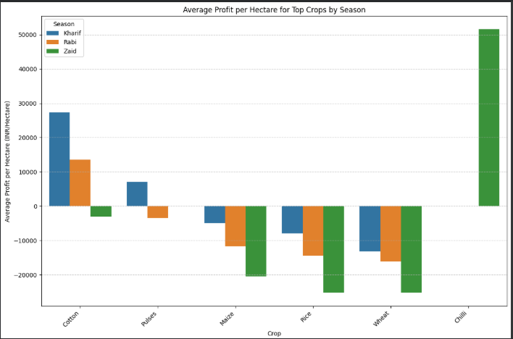
RESULTS

Slide 10
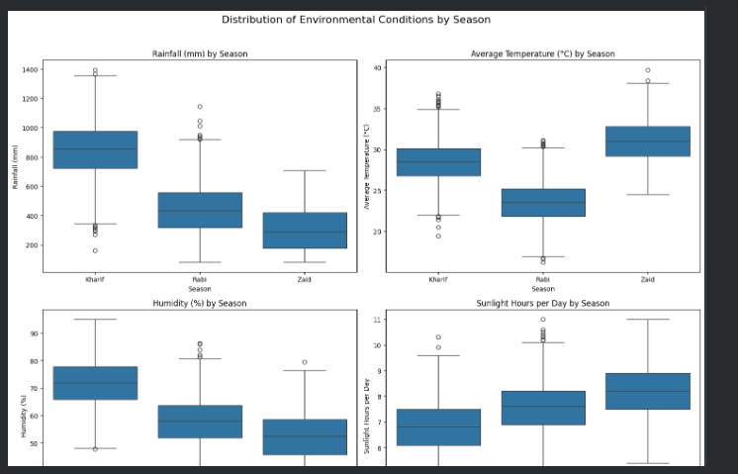
RESULTS

Slide 11
Future scope
Real-time Pipeline Integration: Connect live database streams (e.g., PostgreSQL, AWS S3) for continuous data ingestion.
Predictive Modeling: Incorporate Machine Learning models (e.g., forecasting, clustering) alongside visual analytics.
Automated Reporting: Add automated PDF/Email summary report generation scheduled on a daily or weekly basis.

Slide 12
GitHub Link
https://github.com/sahuji7618/Seasonal-Agriculture-Performance-Data-Analytics.git

Slide 13
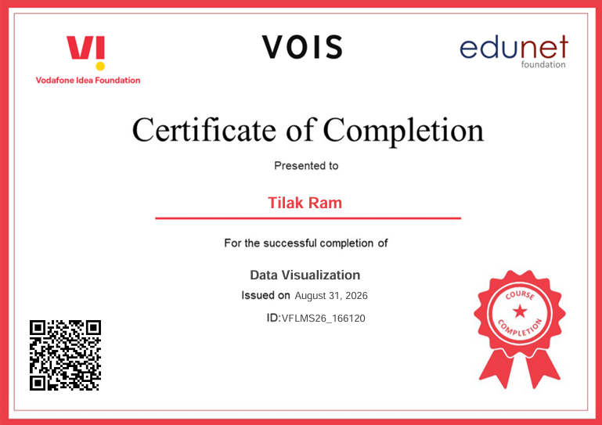
VOIS Course completion certificate - Course name- Data Visualization

Slide 14
Thank you
This project delivers a seasonal agricultural performance analysis by transforming dataset metrics into visual insights and yield models across Kharif, Rabi, and Zaid seasons. Built with Python, Pandas, Seaborn, and Scikit-learn, it highlights crop drivers and seasonal profitability. Sincere thanks to VOIS and AICTE for their invaluable guidance in this Data Visualization program.
.
.

